Slide 1
Tools and Resources to help cope with stress or anxiousness
Understanding what’s happening – Building our resources
Ms. Cumiskey – Presentation College, Carlow

Slide 2
Stress is a normal, universal human experience and has been around a long time!
Eustress, or good stress, is stress that benefits our health, like physical exercise or getting a promotion. Distress on the other hand, is stress that harms our health and often results from imbalances between demands made upon us and our resources for dealing with these demands. The latter is what most people think about when they talk about stress. However, if handled well stress can increase motivation and stimulate.

Slide 3
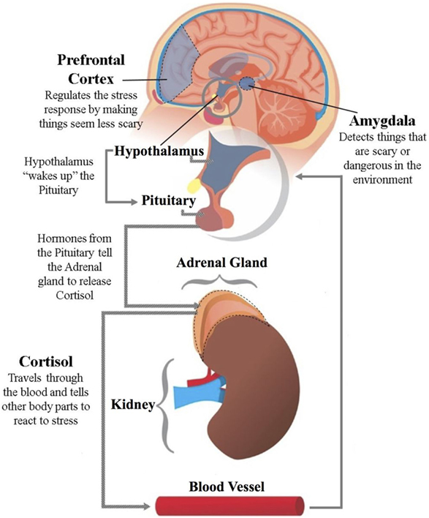
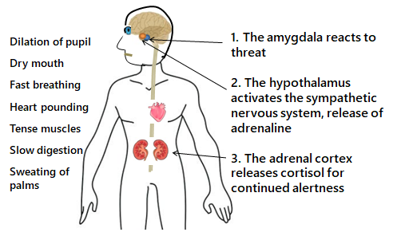
The fight, flight or freeze response

Slide 4
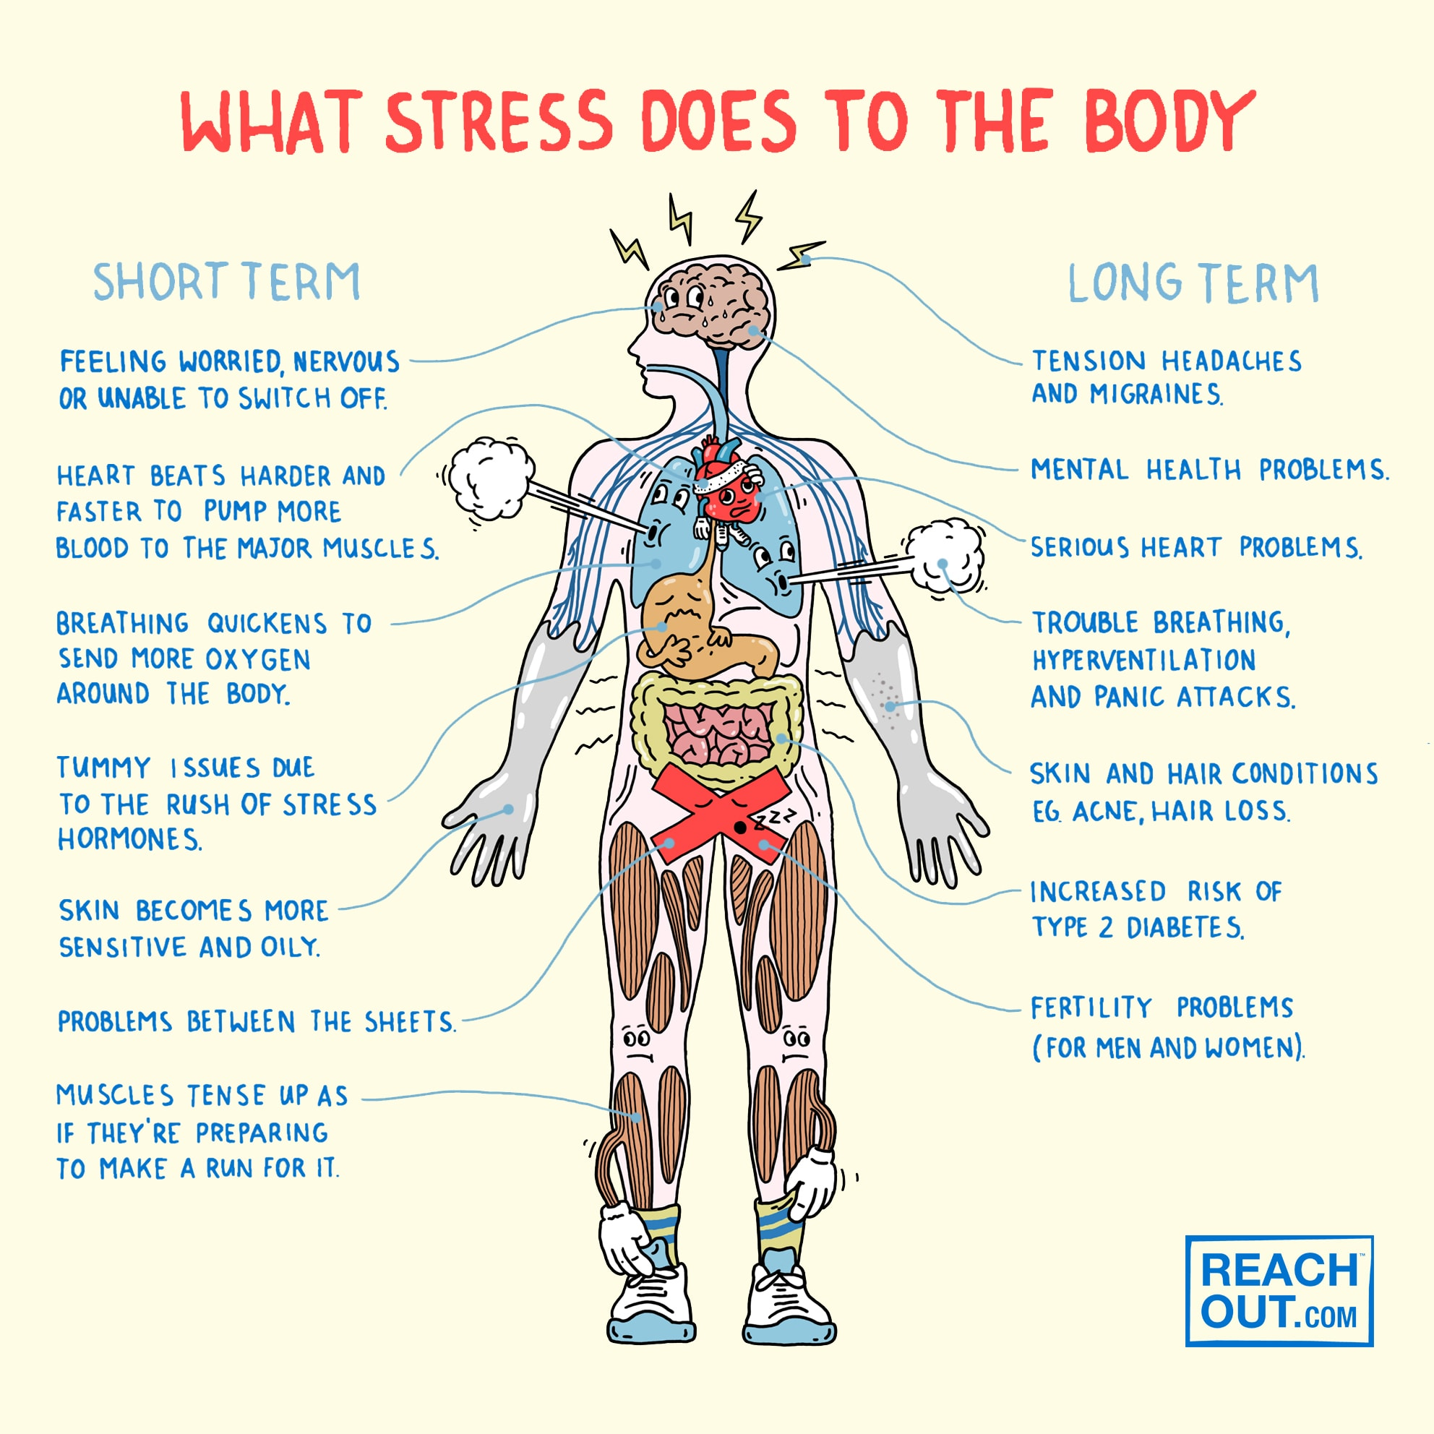

Slide 5
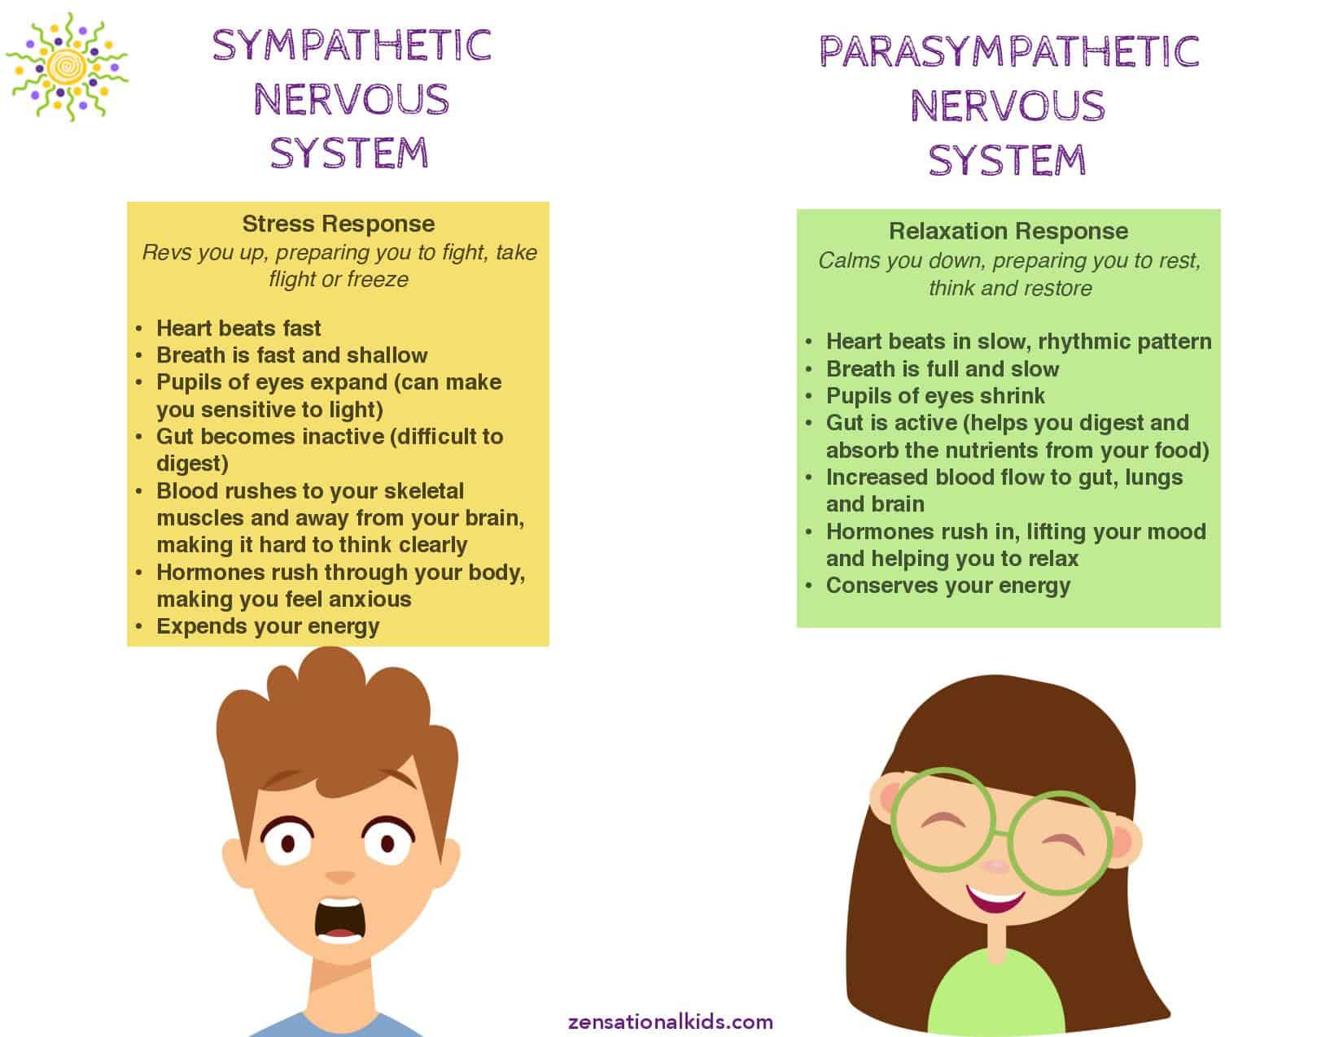

Slide 6
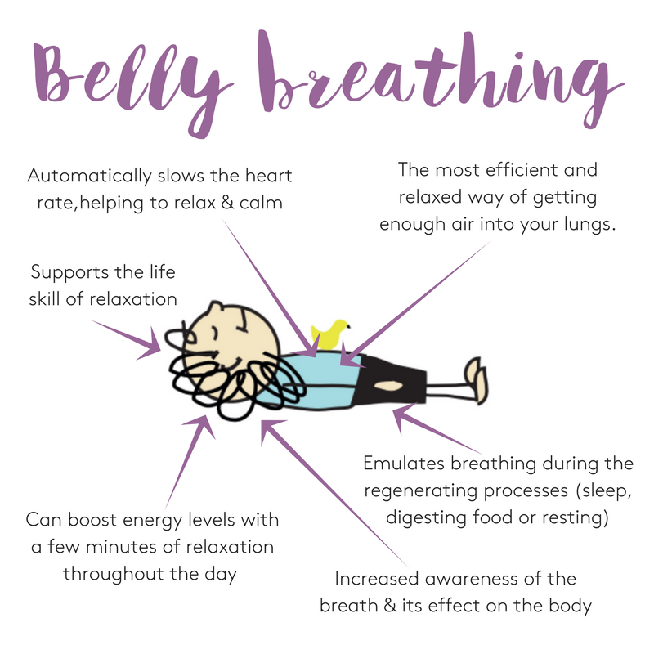
Initial Belly Breathing Practice – Try It Now!
Put your hand on your belly.
Push it out by drawing in a deep breath through your nostrils.
Exhale fully through your mouth, pushing the hand in towards your spine. Get all the air out.
Repeat three times.
Do it all again, only this time focus on physically expanding the belly, the lower chest, then the upper chest in sequence as you breath in deeply.
Practice this anywhere. Lying down, sitting in a chair or standing up.

Slide 7
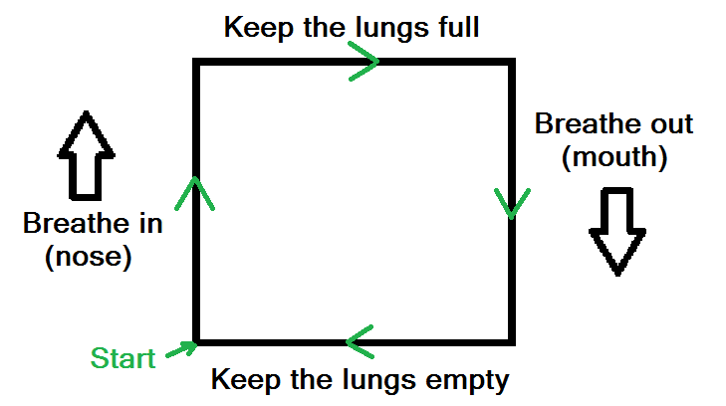
Next up is Box Breathing…
The Benefits of Box Breathing
In just a single four minute session you should be able to reduce stress and anxiety, clear the mind and calm nerves.
By learning box breathing you can increase blood flow, increase learning and skill development, and improve focus and attention.
If you make it a regular part of your routine you may notice increased energy and awareness.

Slide 8
Box Breathing
Visualise a square. You’re starting in the bottom left corner.
Inhale
Breathe in steadily through the nose for a count of 3 to 5 (experiment with a count that suits you). This is taking you up the side of the square.
The Hold (full)
Once your lungs are full, maintain for a count of 3-5. When holding your breath, you aren’t looking to create tension, so try to let your breath ‘float’ by keeping the airway open. ‘Float’ for the same time as you spent breathing in (hence the box).
Exhale
Follow that with a controlled exhalation through the mouth (try to get ALL the air out).
The Hold (empty)
With completely empty lungs, wait four a count of four before inhaling again. As with the top hold, we aren’t looking for tension here, so try and keep the body calm.
Repeat the box for a set number of breaths (e.g. 10), or for time (e.g. 5 minutes). Find a count that fits your breathing pattern and doesn’t leave you gasping for air or rushing your way through. The more you focus on the act of breathing, the better the effect.

Slide 9
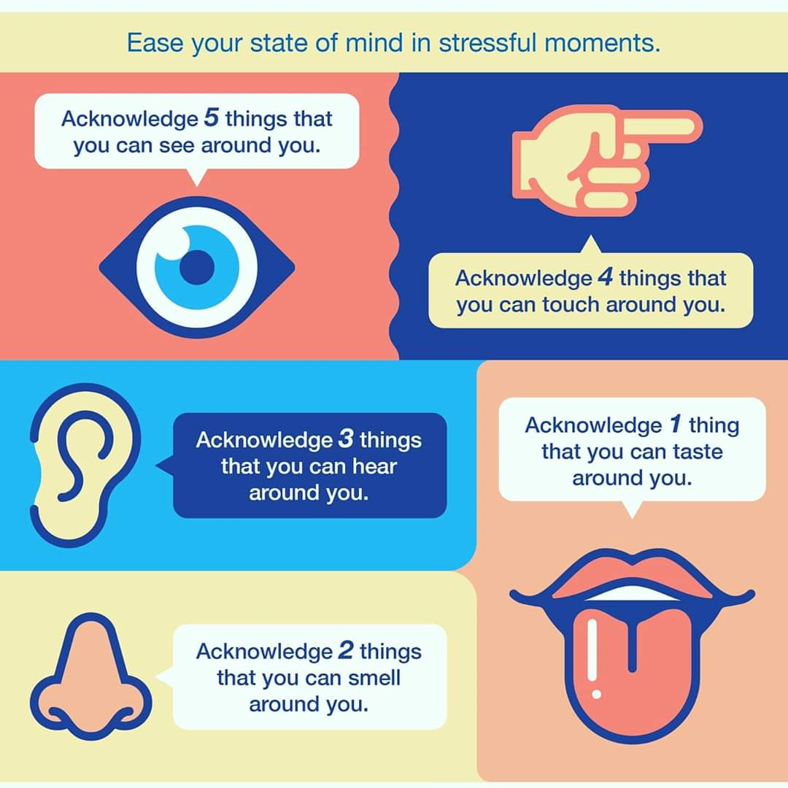

Slide 10
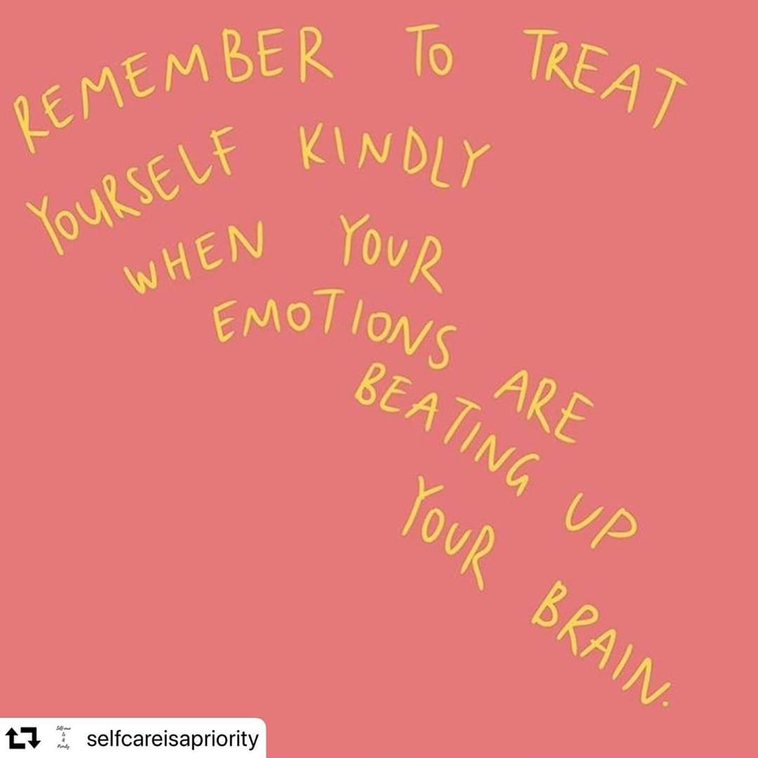

Slide 11
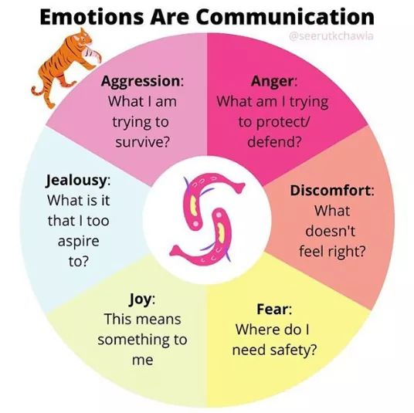
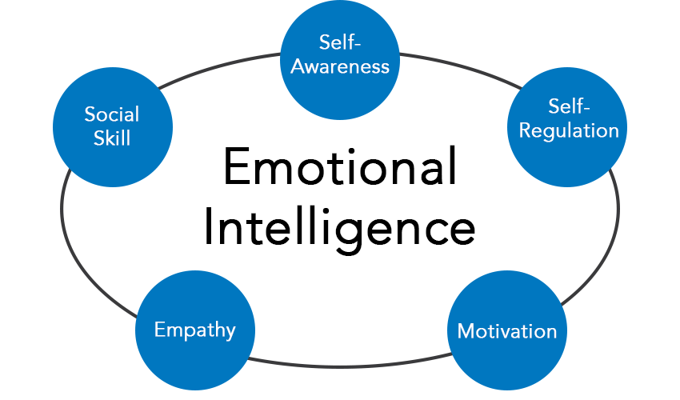
Understanding your emotions can help develop your emotional intelligence

Slide 12
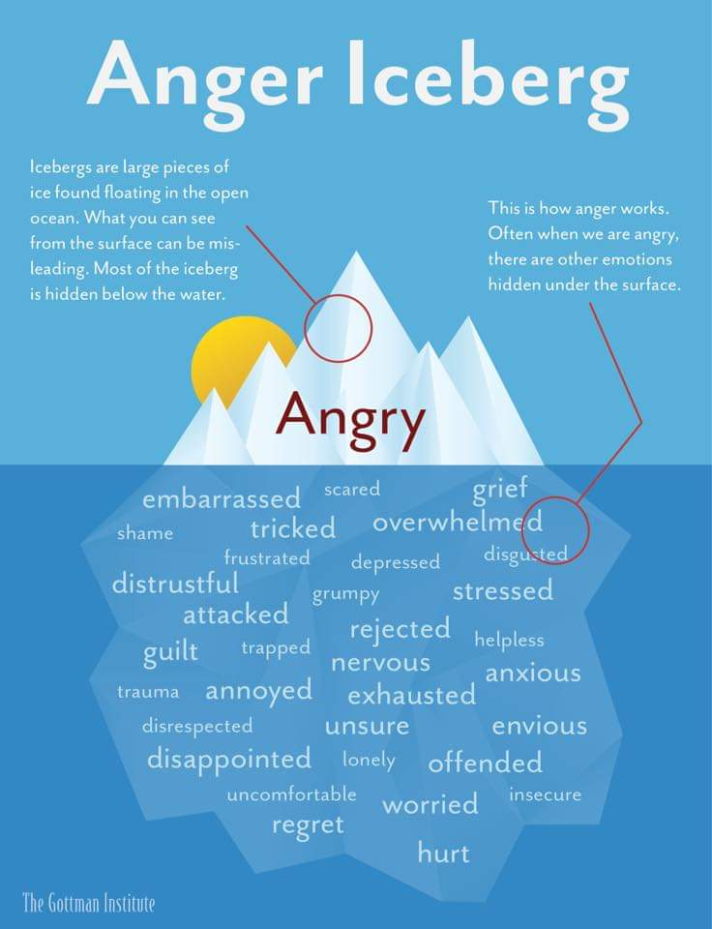
An example of anger and what it can mean underneath the surface.
Something to remember when you are faced with your own anger or someone elses.

Slide 13
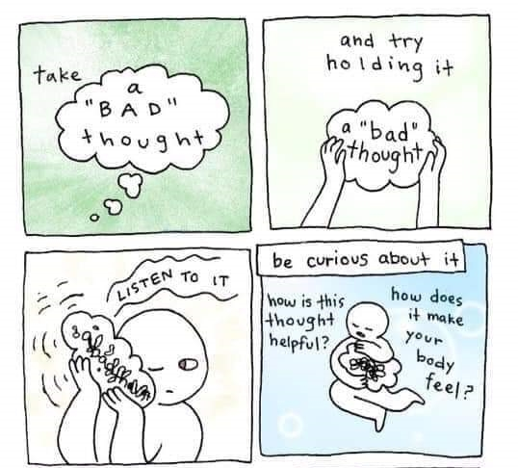
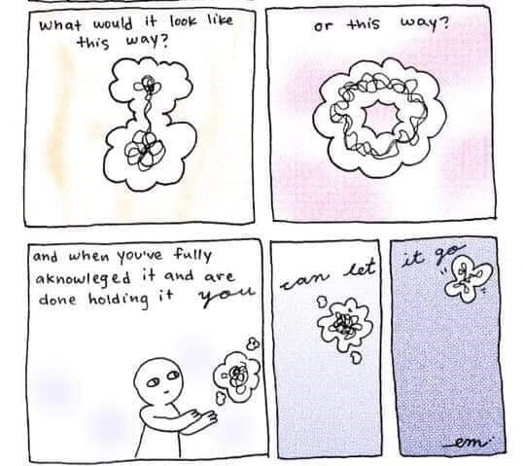

Slide 14
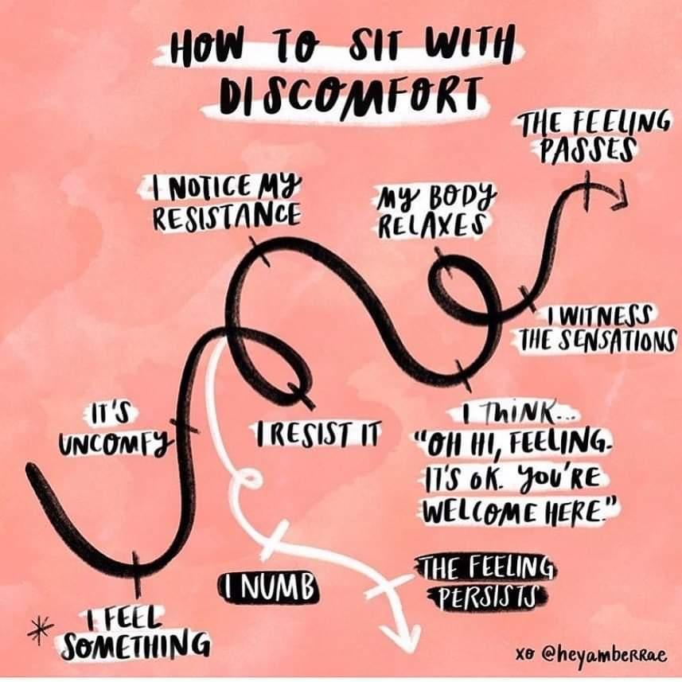

Slide 15
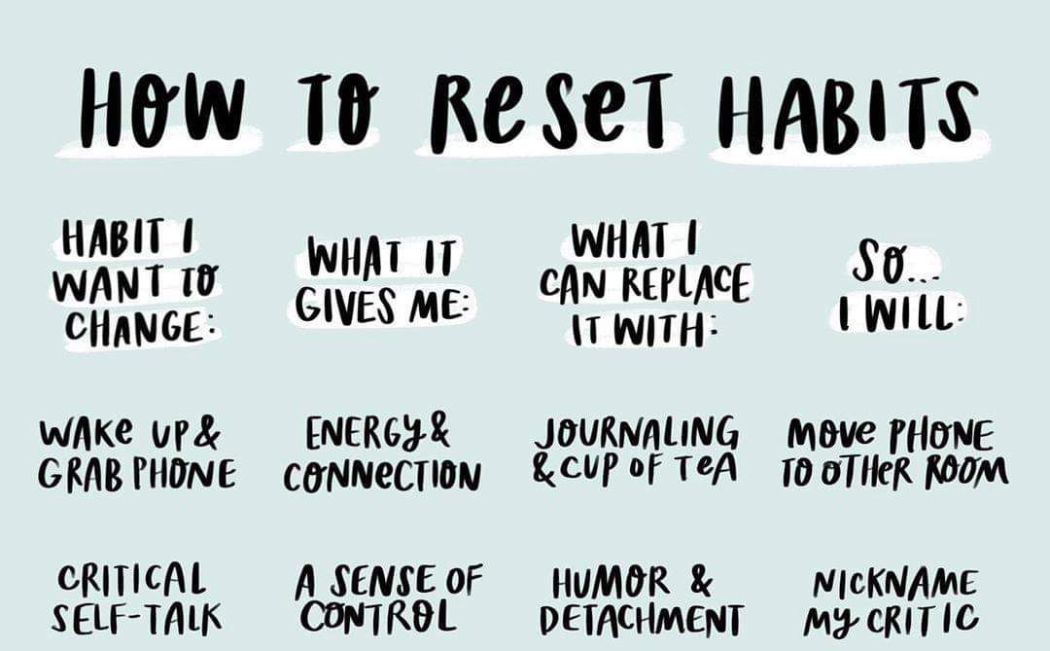
What would the name of your inner critic be and what would they look like?

Slide 16
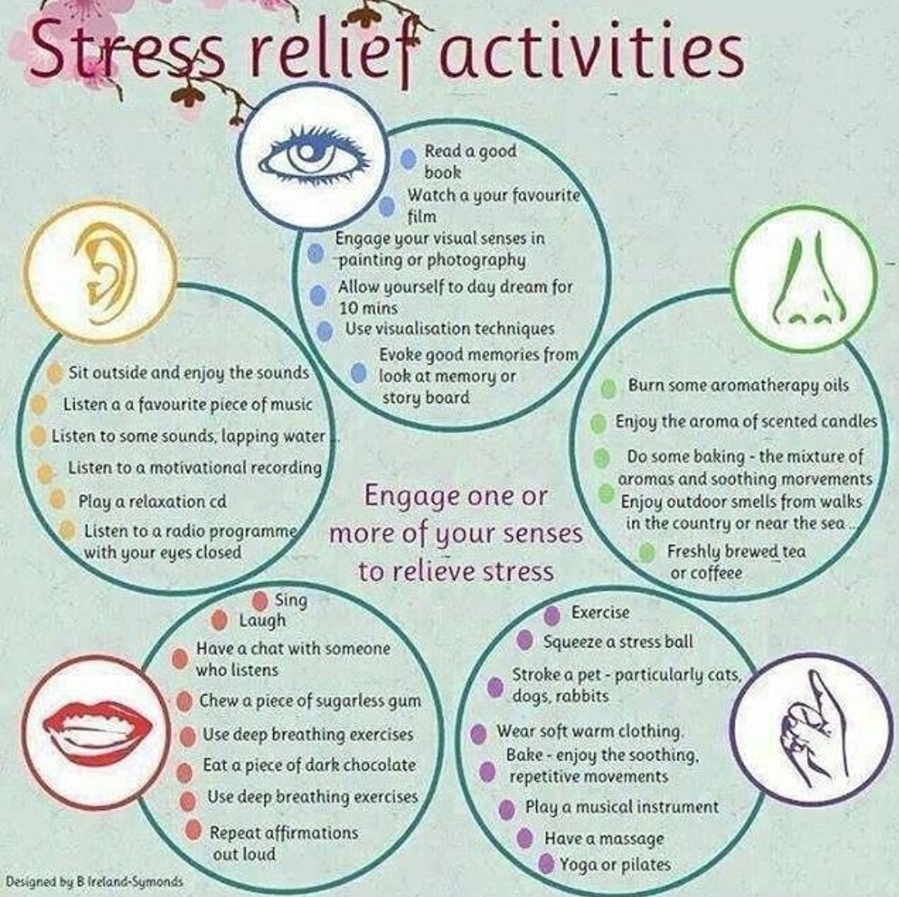
Write your own personal list of stress relief activities.
Think of how you can use the different senses.
Put it in a place you will see it and pick one or two to do each day.

